Slide 1
AIjaib
Intelligent City – Vandalism Prevention and Its Response with AI

Slide 2
Members
Ginanjar NUR RAHMAT
Azzahra DOMOARIGATO
Galang HAKIM

Slide 3
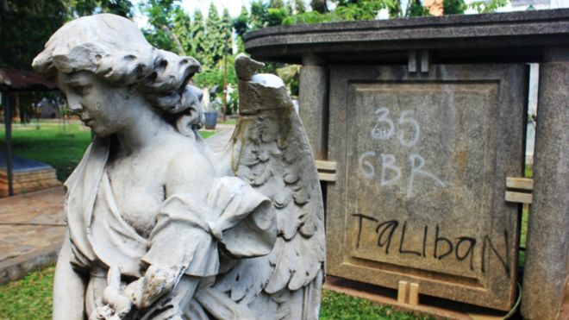
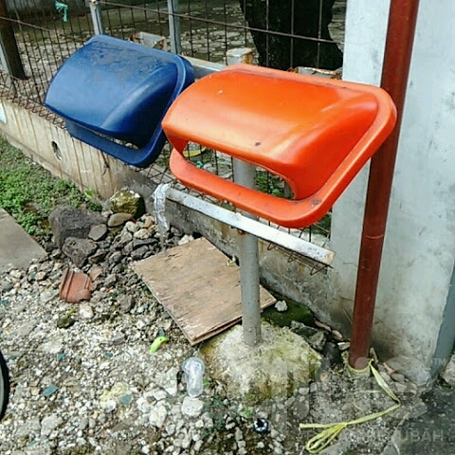
Vandalism and Its Effects
Decreasing property values in a neighborhood.
Signifying unsafe and neglected neighborhood.
Discouraging tourism by disfiguring city‘s visual
aesthetic and inducing feeling of unsafe in the area.
Significant costs to repair the damages.
Some damages are irreversible in historical monuments.
Public infrastructure utilitization is not optimal or
even interrupted.

Slide 4
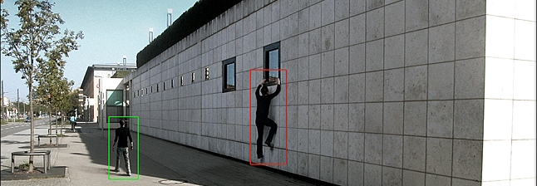
Solution with AI
Real-time monitoring and human-like perception.
Real-time response either to prevent, to intercept or to deter.
Scalable with no extra human resource on the ground needed.
Responses are event-based so system’s power consumption is optimized.

Slide 5
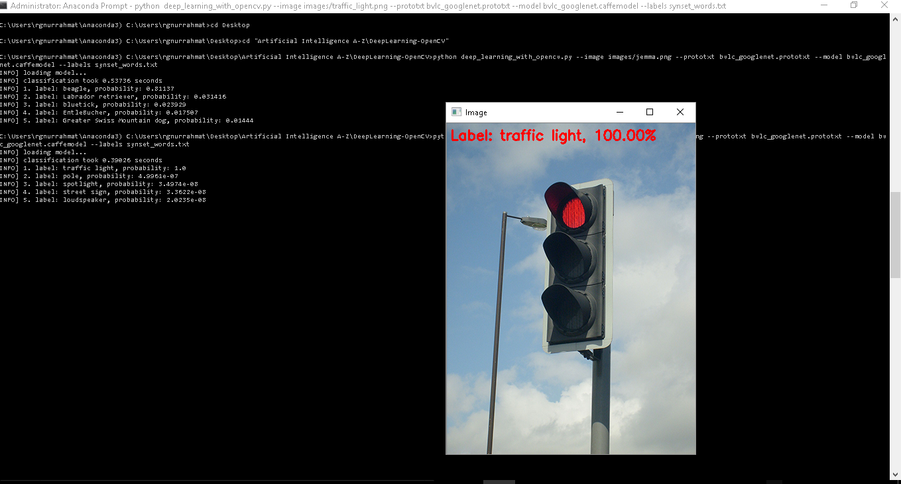
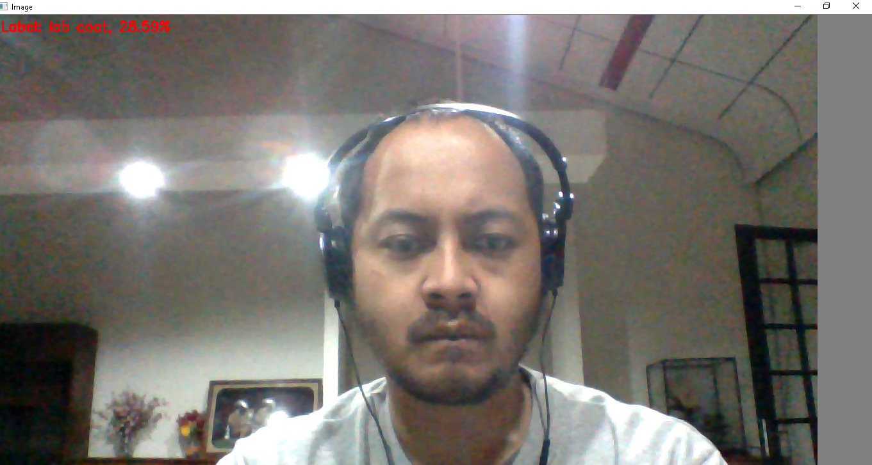
AIjaib Solution
Detecting Grafitti movement.
Recording the crime.
Sending hot point locations and image to nearby officers for further action. ( future development )

Slide 6
References
Vandalism in Schools Costs Scotland £4.5M http://www.express.co.uk/news/uk/747739/scotland-schools-vandalism-costs-education-system
Vandalism Costs Belgian Rail €5M A Year https://gopressmobility.be/2017/04/28/vandalism-costs-belgian-rail-5-million-euro-year/
Masih Diuji Coba Simpang Susun Semanggi Sudah Dikotori dengan Coretan http://megapolitan.kompas.com/read/2017/08/01/19360671/masih-diuji-coba-simpang-susun-semanggi-sudah-dikotori-dengan-coretan

